Slide 1
INTERRUPTS
HCM - 2021

Slide 2
Agenda
Polling vs. interrupt programming styles
General interrupt mechanism in microcontrollers
ARM Cortex-M4’s interrupt system

Slide 3
Common Programming Patterns
Software polling
Interrupt (event-driven)
DMA (direct memory access)
Good for moving large amount of data, e.g., audio
RTOS (Real-Time Operating System)
Simplifies a complex application into smaller, concurrent tasks
Combination of methods above

Slide 4
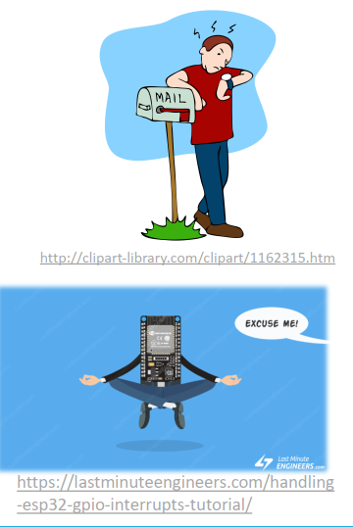
Polling vs. Interrupt
Polling
Program keeps checking for a certain event to happen
E.g. GPIO pin status changed, or timer
Interrupt
Program keeps doing regular routines
When an event of interest happens, the program suspends normal execution and executes code that handles the event

Slide 5
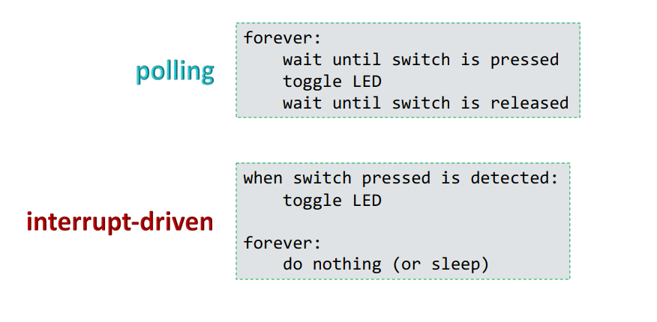
Polling vs. Interrupt (cont’d)
Considering pseudo-code for switch-toggled LED

Slide 6
Interrupts vs. Exceptions
An exception is an event that alters normal program flow
Interrupts are exceptions caused by hardware events, such as peripherals and I/O
Other exceptions are:
Faults – caused by faulting instructions, such as division by zero
Traps – deliberately caused by user program to trigger certain event or service
Aborts – used only to signal severe problems; operation no longer possible

Slide 7
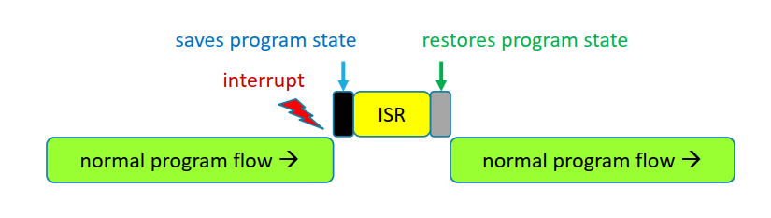
Interrupt Service Routine (ISR)
A special block of code that gets executed automatically by the CPU when a corresponding interrupt occurs
Also known as Interrupt Handler
or Exception Handler in general

Slide 8

Maskable vs. Non-maskable Interrupts
Maskable interrupts can be disabled by the program
To perform critical operations that must not be interrupted
Most interrupts are maskable
Non-maskable interrupts cannot be disabled
Used to indicate critical events, e.g., reset, power failure

Slide 9
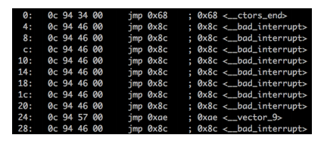
Locations of ISRs
Should be at fixed locations so CPU can find them easily
Problem: different ISRs have different lengths
Possible solutions
A table of ISR locations (function address) is maintained at a fixed memory location
This table is called Interrupt Vector Table
ISRs may be changed dynamically by the application
AVR’s vector table is filled with JMP instructions, while Cortex-M’s vector table stores ISR addresses

Slide 10
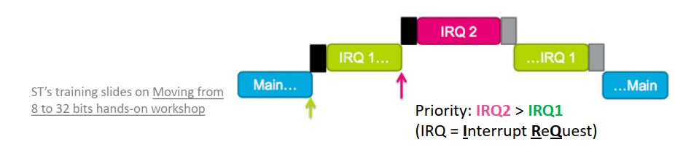
Interrupt Priorities
Many MCUs support different interrupt priorities
An interrupt with a higher priority can preempt the execution of a lower-priority interrupt
Priorities may be fixed or programmable
Program can also choose to disable interrupts whose priorities are below a threshold

Slide 11
Interrupt Latency
Interrupt latency→ amount of time to respond to an interrupt
Depends on:
How long the interrupt is disabled
Time to execute ISRs of higher priority interrupts
Time for processor to stop current execution, do necessary save state, and start executing the ISR
Time taken for the ISR to save context and start executing instructions that count as a ‘response’
Factor 3 depends on HW, not under software control
Other factors are controlled by writing efficient code that are not too long
Make ISRs short

Slide 12
Writing an ISR
ISR should finish as quickly as possible
ISR does not accept parameters, nor returns a value
To communicate with the main program, use global variables or shared data structures
These variables must be declared volatile
For events that need complicated handling, set a flag to notify the main code
Accessing variables shared with ISR must be atomic
Especially read-modify-write memory update sequence
An interrupt can happen in the middle of variable access
Wrap these statements inside a critical section (disable interrupt, etc.)

Slide 13
STM32F4’s Interrupt System
Controlled by Nested Vectored Interrupt Controller (NVIC)
67 maskable interrupt channels
16 programmable priority levels
4 bits of interrupt priority are used
Low-latency exception and interrupt handling

Slide 14
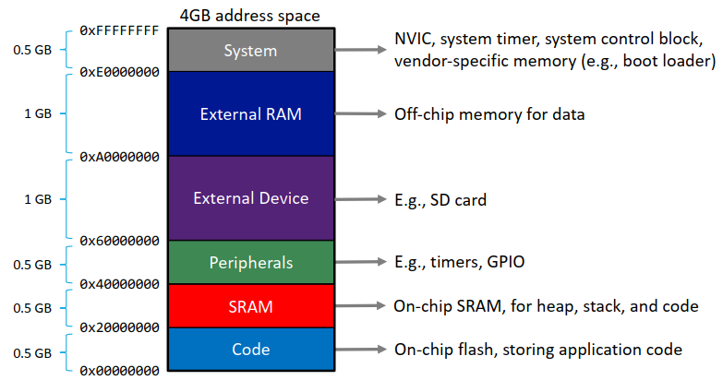
Cortex-M4’s Memory Map

Slide 15
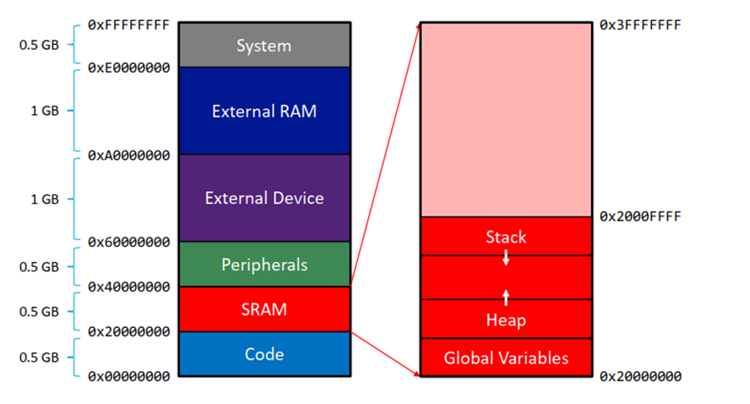
Data Memory

Slide 16
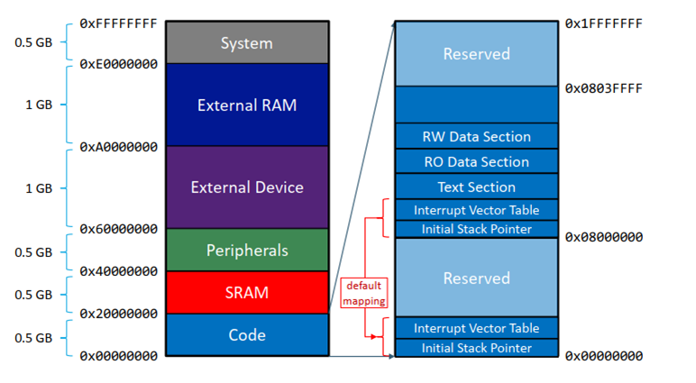
Instruction Memory

Slide 17
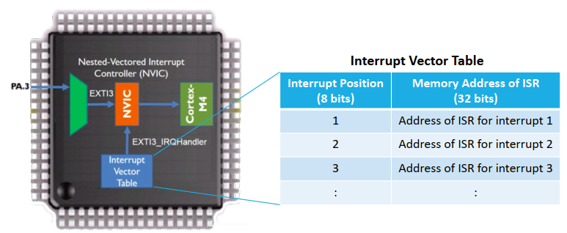
NVIC Operation
When an interrupt signal is detected, NVIC looks up the ISR address from the interrupt vector table
The address is then passed to the CPU

Slide 18
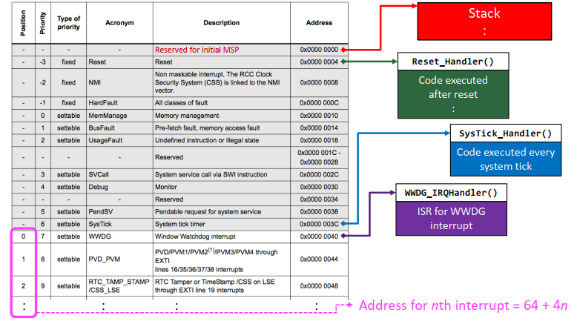
Interrupt Vector Table

Slide 19
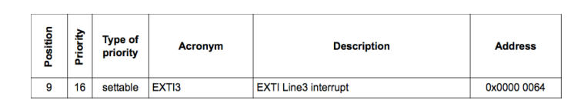
Example: ISR Address
Find the interrupt vector table entry that contains the address of EXTI Line3 interrupt handler
EXTI Line3 interrupt’s position is 9
Entry address = 64 + 4*9 = 100 = 0x64
Notes: ISR address found in the table entry always has LSB
set to 1 to indicate THUMB instruction set

Slide 20
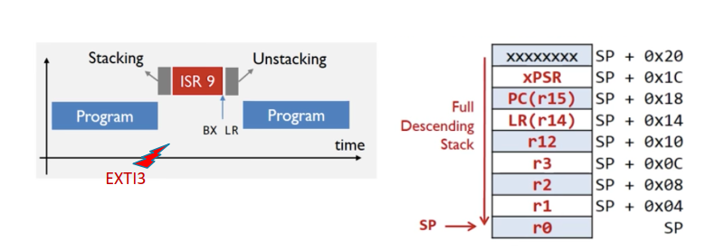
Single Interrupt Operation

Slide 21
Cortex-M4’s Interrupt Priorities
Four bits → 16 different priorities
The four bits can be divided into
Preemption priorities (0-4 bits)
Sub priorities (0-4 bits)
An interrupt with smaller preemption priority number (higher priority) preempts the execution of an interrupt with larger preemption priority number
For pending interrupts of the same preemption priority, one with the smaller sub priority number will be serviced first

Slide 22
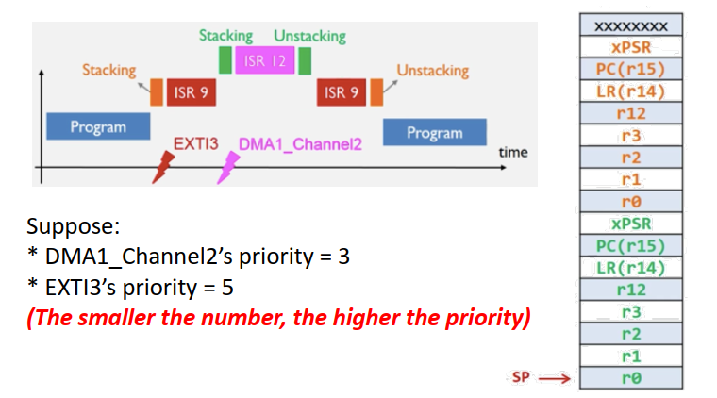
Nested Interrupts: Preemption

Slide 23
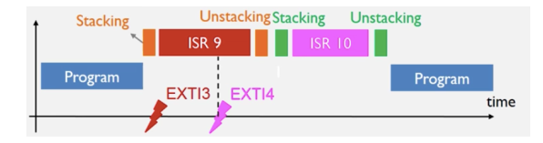
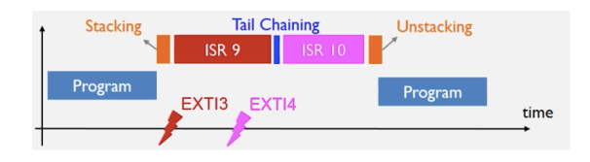
Nested Interrupts: Tail Chaining
Suppose EXTI4 is of lower priority than EXTI3
Cortex-M4 optimizes the unnecessary unstacking/stacking operations, saving clock cycles

Slide 24
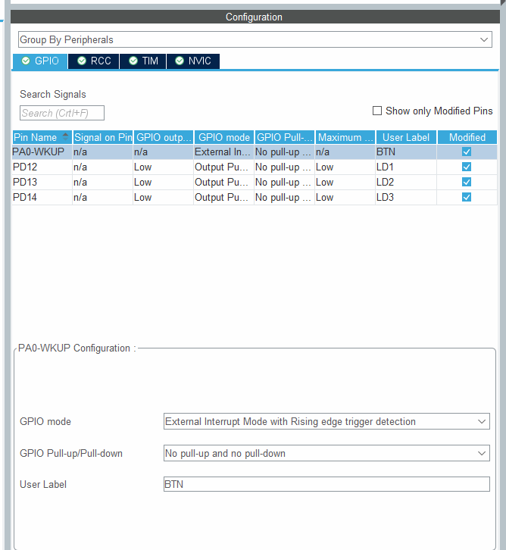
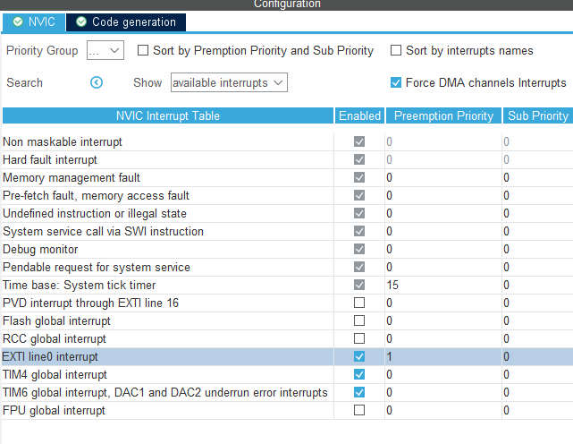
Interrupt - CubeMX

Slide 25
QUESTION ?

